Slide 1
DevOps
Sundar Rajan Renganathan

Slide 2
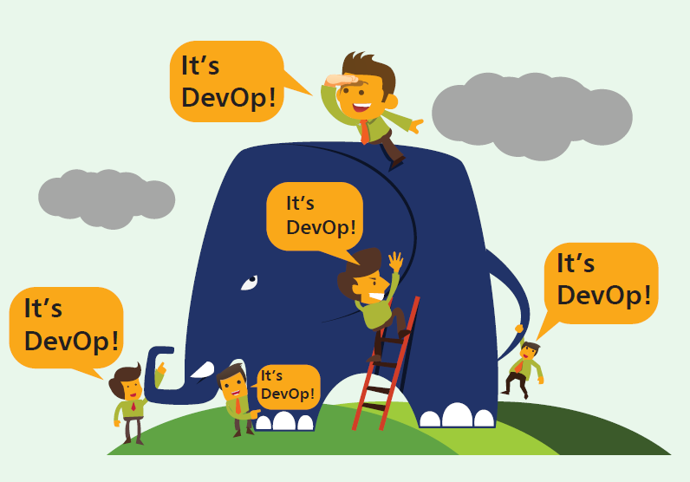
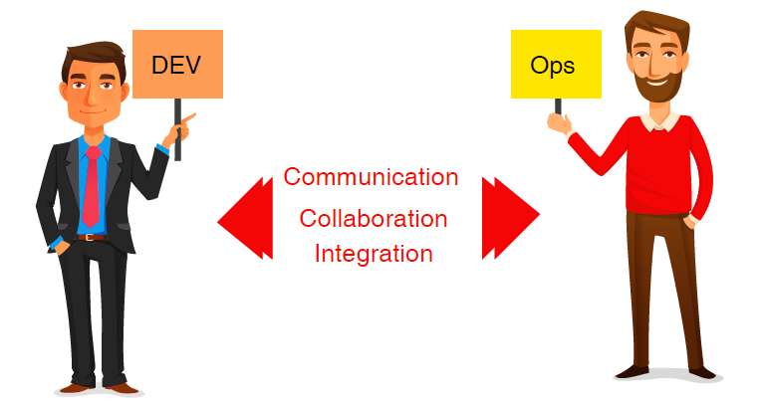
What is DevOps?
DevOps is an approach based on agile and lean principles in which business owners, development, operations, and quality assurance team collaborate to deliver software in a continuous stable manner
DevOps is an environment that promotes cross practicality, shared business tasks and belief
DevOps is a movement that improves IT service delivery agility
DevOps is a culture that promotes better working relationship within the company
DevOps is a set of practices that provides rapid, reliable software delivery

Slide 3
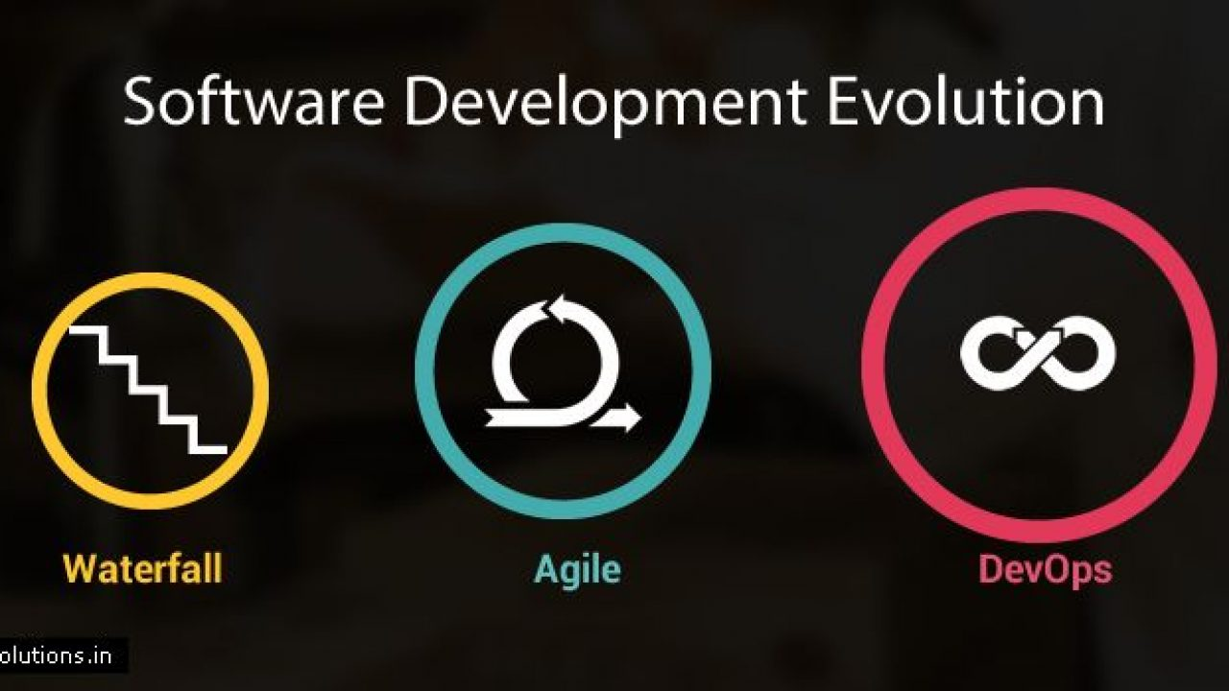
Evaluation of DevOps?

Slide 4
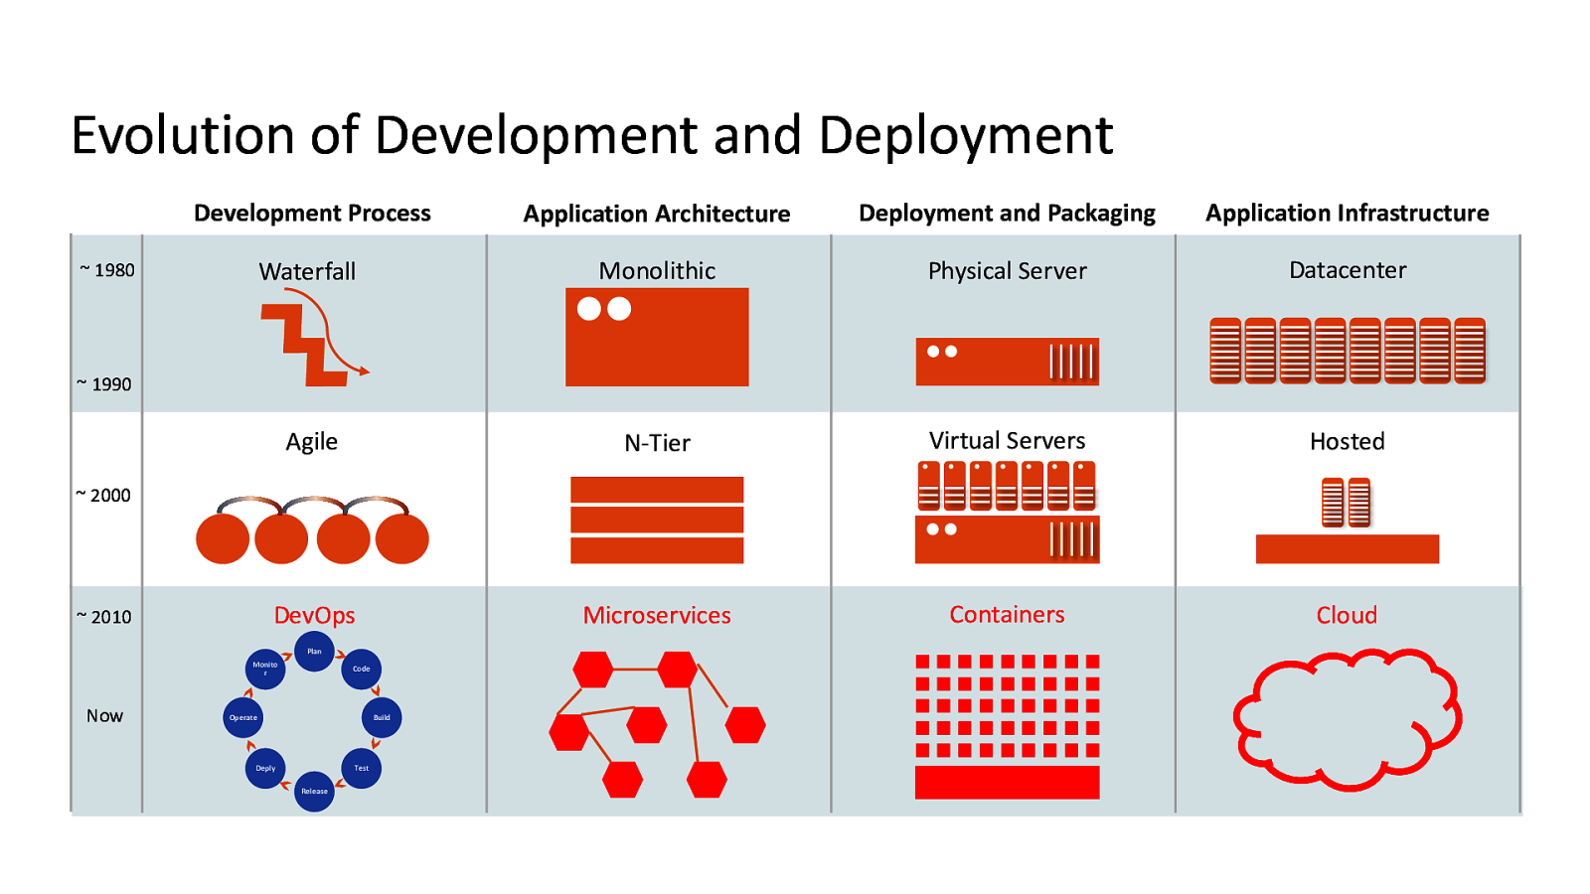
Evaluation of DevOps?

Slide 5
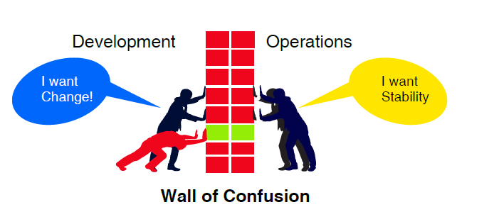
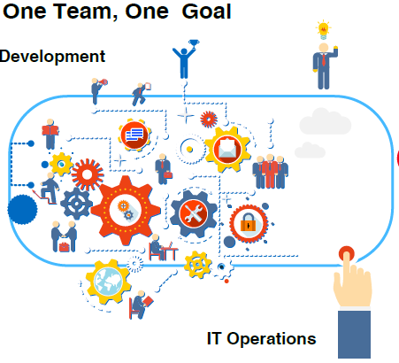
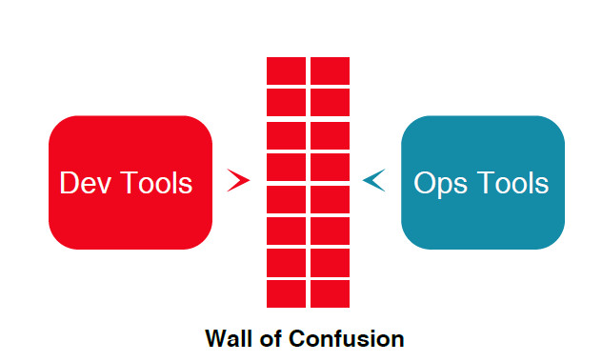
Why DevOps?
DevOps break down the walls between development and operations team, unifying development to operations for better, faster outcomes.

Slide 6
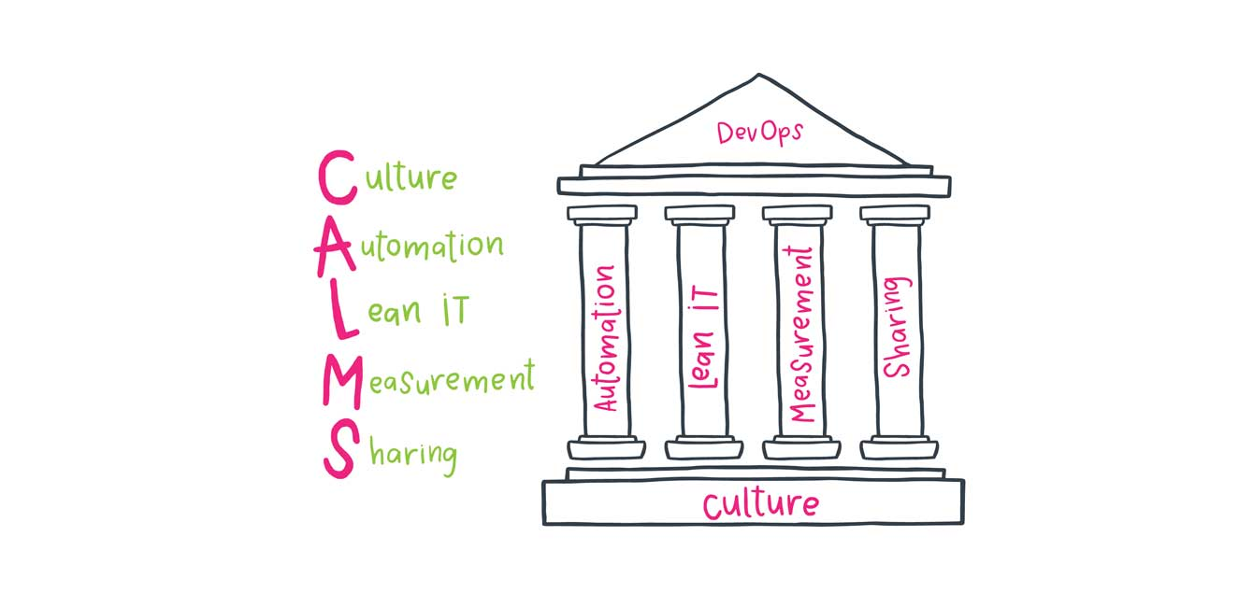
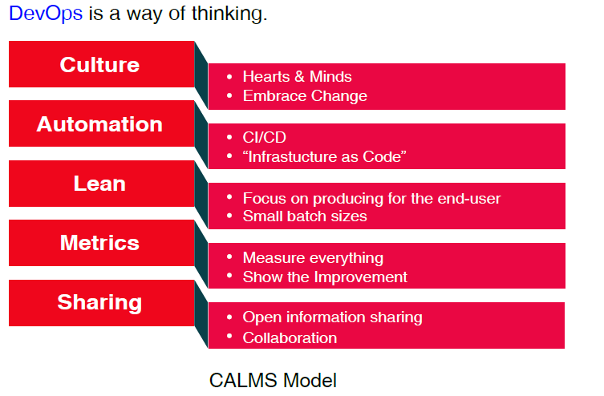
How DevOps works?

Slide 7
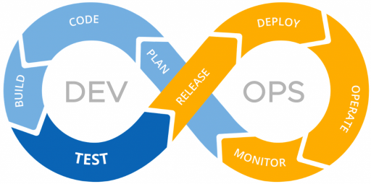
Principles of DevOps
Eliminate the blame game, Open post-mortems, Feedback, Rewarding failures
Continuous Delivery, Monitoring, Configuration Management
Business value for end user
Performance Metrics, Logs, Business goals Metrics, People Integration Metrics, KPI
Ideas, Plans, Goals, Metrics, Complications, Tools

Slide 8
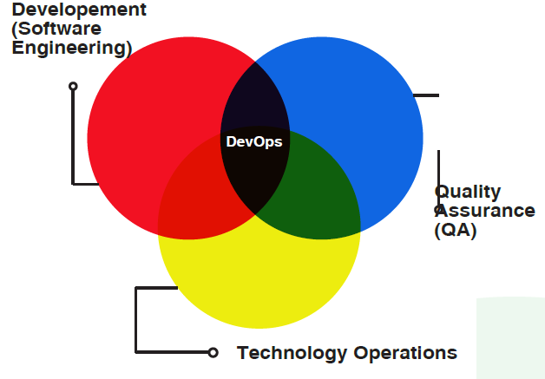
Benefits of DevOps
DevOps combines the best of all teams
providing the following:
Develops and verifies against production-like systems
Reduces cost/time to deliver - Deploy often, deploy faster with repeatable, reliable process
Increases Quality - Automated testing, Reduce cost/time to test
Reduces Defect cycle time - Increase the ability to reproduce and fix defects
Increases Virtualize Environments utilization
Reduces Deployment related downtime
Minimizes rollbacks

Slide 9
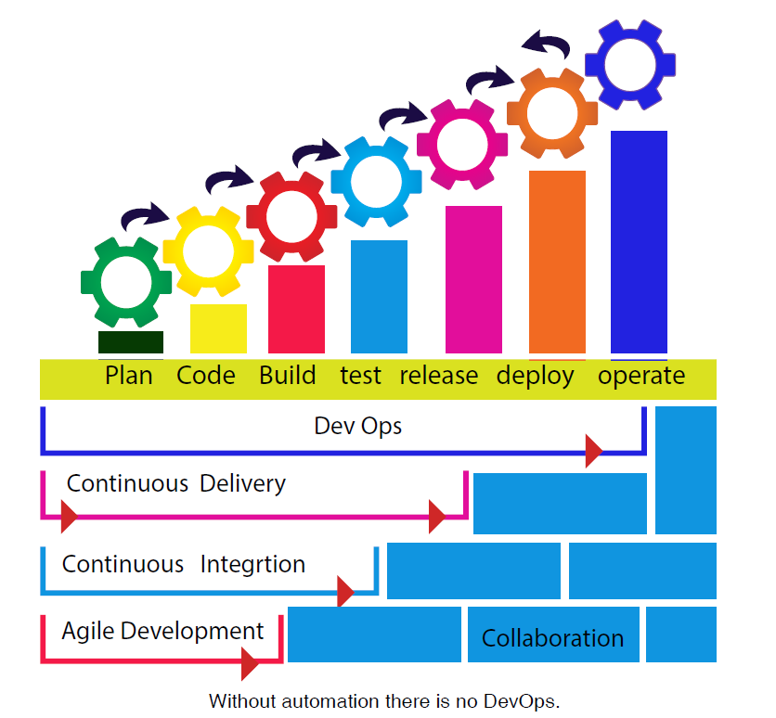
No DevOps without Automation
Automate Provisioning - Infrastructure as Code
Automate Builds – Continuous Integration
Automate Deployments – Defined Deployment Pipeline and Continuous Deployments with appropriate configurations for the environments
Automate Testing – Continuous Testing, Automated tests after each deployment
Automate Monitoring – Proper monitors in place sending alerts
Automate Metrics – Performance Metrics, Logs

Slide 10
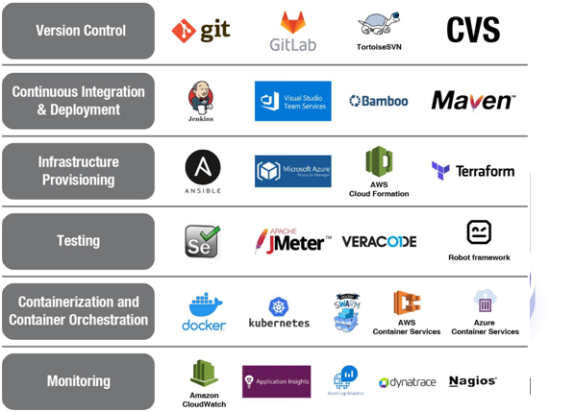
Some tools in DevOps

Slide 11
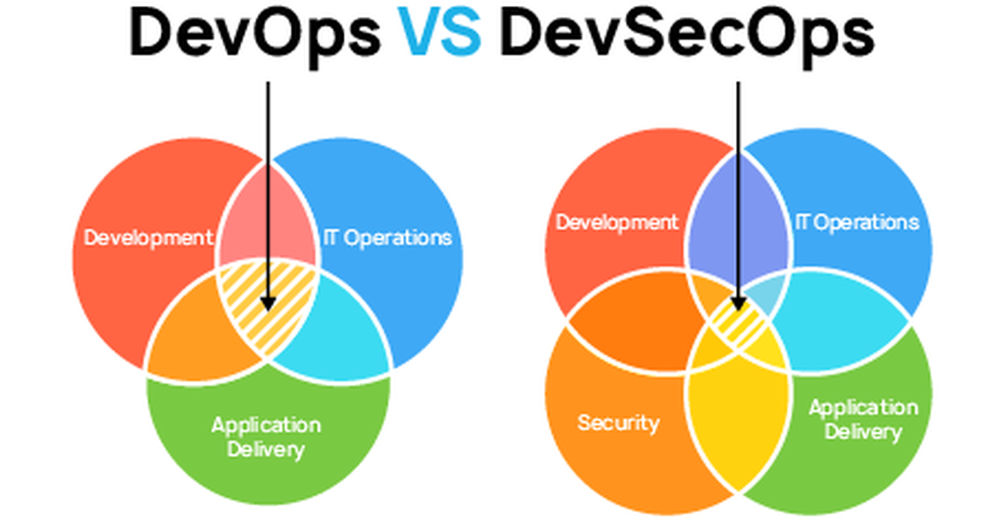
DevOps Vs. DevSecOps

